Slide 1
Physical demands and Ergonomics
Chapter 2.5

Slide 2

In Europe, over 40 million workers are affected by musculoskeletal disorders (MSDs) attributable to their work
Physical demands as persistent as ever
European workers remain as exposed to physical demands as they did 20 years ago, reflecting the fact that many Europeans’ jobs still involve physical labour.
Fifth European Working Conditions Survey (2010)

Slide 3
Simple cause effect model for workrelated MSDs
Physical activities:
lifting, kneeling, pushing, …
Exposure criteria
posture
movement
applied force
Is there evidence?
physical capacity
workload
ability to recover
workrelated MSD
Specific MSD

Slide 4
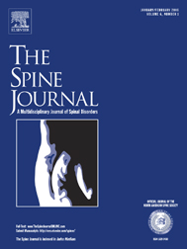
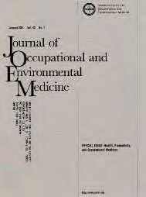


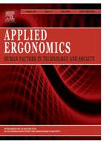

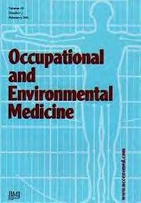


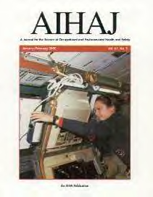


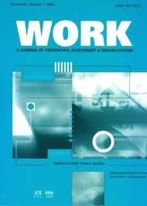
A great number of medical journals report on workrelated risks for MSDs
4

Slide 5
Simple cause effect model for workrelated MSDs
Physical activities:
lifting, kneeling, pushing, …
Exposure?
Kneeling:
OR=2.1 (95% CI 1.4-3.3)
(10 yrs & > 80 min/day)
OR=3.4 (95% CI 1.3-9.1)
(>30 min/day)
OR=1.8 (95% CI 1.2-2.6)
(1 year & ≥ 60 min/day)
posture
movement
applied force
workload
workrelated MSD
Knee Osteoarthritis
Han-De Groot et al. 2007

Slide 6
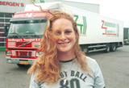
Case:
Cindy (32 years) and non-specific low back pain
Doc,
Are my back complaints aggrevated by my work?

Slide 7
Remember WARP
  Work: could the work of the patient be (part of) the cause or the aggravation of his/her complaint / disease? (Effect of work on health)
  Activities: could the complaint / disease of the patient have consequences for his/her activities and participation in work (Fitness for work)
  Referral: should / can I refer my patient to an occupational physician or another specialist
  Prevention: Can I do something to prevent the (return of the) complaint / disease?

Slide 8
Occupational history taking
Driver of packed goods
60-80 adresses
150-220 number packages
<1 – 40 kg packages
120-180 km
Driving 8 hrs
Manual loading 1 hr
Manual unloading 0.5 hr

Slide 9
Low back pain of Cindy: workrelated?
A penny for your thoughts
Easy
Zzz…
Good questions…
Not me
Sure why not
Vigilate et orate!

Slide 10
Work related risk factors
Manual materials handling
Does worker handle objects > 5kg >2x per minute for total of > 2 hours per working day, or objects > 25kg > 1x per day?
Does worker handle objects > 15 kg during > 10% of working day?
Bending or twisting of the trunk
Does worker work with trunk bent and/or twisted > 20º for > 2 hours per working day?
Does worker work with trunk bent and/or twisted > 40º for > ½ hour per working day?
Whole body vibration
Is worker exposed to average vibration levels > 0.5 m/s² per working day?
Has worker been exposed to average vibration levels > 1 m/s² per working day for ≥ 5 years?

Slide 11
A
Manual materials handling
= lifting, holding or moving object by hand without help of mechanical tools
A1 Does worker handle objects > 15kg during > 10% of working day?
Yes, score 7 & go to B No, go to A2
A2 Does worker handle objects > 5kg during > 2x per min for total of > 2 hours per working day, or objects >25 kg >1x per working day?
Yes, score 4 No, score 0
Score
4
B
Bending / twisting of trunk
=bending trunk forwards or sideways and/or twisting trunk
B1 Does worker work with trunk bend and/or twisted > 40° for >1/2 hour per working day?
Yes, score 7 & go to C No, go to B2
B2 Does worker work with trunk bend and/or twisted > 20° for > 2 hours per working day?
Yes, score 5 No, score 0
0
C
Whole body vibration
C1 Has worker been exposed to average vibration levels > 1m/s² per working day for >5 yr?
Yes, score 5 No, go to C2
C2 Is worker exposed to average vibration levels > 0,5m/s² per working day?
Yes, score 3 No, score 0
0
Total score (0-19)
4
Notes:
14. Checklist including exposure definitions for the RF and corresponding scores
voorbeeld…………………………(worker lifts >25 kg more than once a day……………scores for other RF 5 and 3 resp.; total score corresponding to the exposure profile of this particular worker is 12)

Slide 12
Step 3: Work-relatedness
4 26 23 22
The probability is 26% that Cindy’s non-specific LBP is due to work-related risk factors (attributable fraction)
Notes:
15. From a table the probability of work-relatedness of the LBP belonging to this exposure score can be read of:
……………………
(vervolg voorbeeld: age <=35 yr, 55%)
(age categories, because apriori probability increases with age……………………. )

Slide 13
Cindy: Stay active!
Physical exercise is recommended in the prevention of LBP, for prevention of recurrence of LBP and for prevention of recurrence of sick leave due to LBP.
http://www.backpaineurope.org/web/files/WG3_Guidelines.pdf

Slide 14
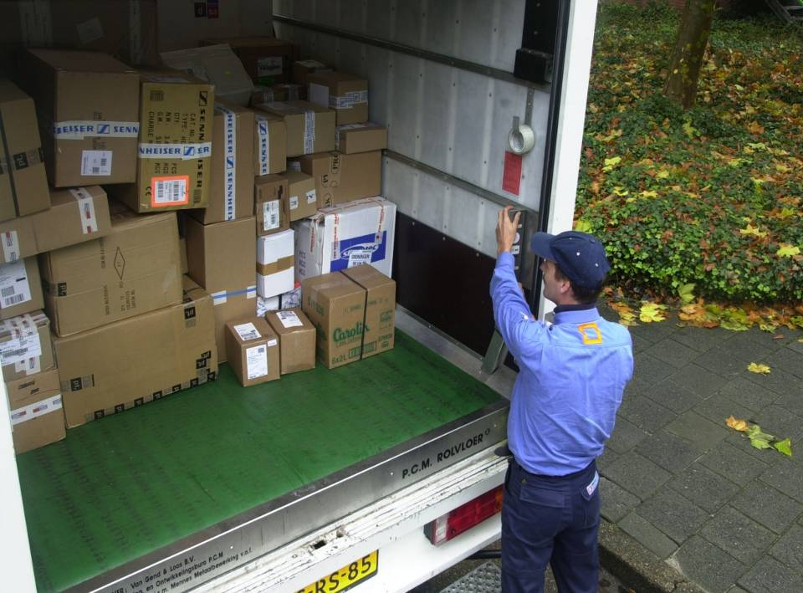
Workplace : use of rolling floor
Large reduction in physical work demands especially for low back and knees compared to the traditional floor:
79% reduction in picking up goods below knee level
45% reduction in frequency climbing in and out cargo space
(Verschoof et al. Does a rolling floor reduce … truck drivers handling packed goods. Applied Ergonomics, 2005;36:595–600)
Engineering firm PCM rolling floor®

